Slide 1
DataVision
An Advance Data Repository
for
Structured DataBae for Data Driven Decisions
Geophysical Services, WON Basin, Vadodara
Singh_mahavir@ongc.co.in
MAHAVIR SINGH
17 June 2026

Slide 2
II - Stage of Development

Slide 3
Dashboard Structure with Side Menu
KPI / Targets / AWP
Projects
Progress Report
Manpower Status
Contract / Tendering Status
Fund Management
Operations
Data Processing
Regional Electronics Lab
Reporting / Appraisals
Pending vs Resolved Issues
Highlights
Technical Reports
Approvals/Permissions
Share Point (Temporary File)
HSE
User Settings
Log Out
KPI / Target / AWP : My Annual target to be uploaded (filled by individuals)
Projects (Inhouse/Outsourced)…Proj1, Proj2…
Progress Report: (Project wise / Block Wise Coverage Details)
Manpower Status: (Operations/RCC/REL)
Contract / Tendering Status : Summarize Status of Contracts.
Fund Management : Status of Fund (Accounting Statement)
Operations: (Base Office, Contracts, HSE, GP03, GP06,….Adding option)
Data Processing: (PG-I, PG-II….Adding option)
Regional Electronics Lab: (Gr-I, G-II….Adding option)
Reporting / Appraisals: (Fortnight / Monthly/Quarterly/ Half-Yearly/DO Report / Consolidated Financial Report)
Pending vs Resolved Issues: Display all the pending Issues with EDC (Expected Date of Compliance).
Highlights: At least one or two highlights from Center or Group.
Technical Reports: (Reconnaissance Reports / Project Reports / Operations Reports / Field Observer Logs)
Share Point (Temporary File): Role Based Sharing / Public Sharing …it should be only in temporary mode that will last for xx hour only (It can be downloaded for future use).

Slide 4
Project Creation Form
Project Name:
Number (e.g. SIG No. / Survey No.):
Survey Type:
Contractor Name:
Area Name:
Section / GPxx / Outsourced:
Party Chief / Project Coordinator:
Year / Field Season:
Start Date / End Date / Project Period
Chronology of Events (option to add events with date)
Target vs Achievement
Survey Objective / Targeted Depth
XY Coordinates of the Area / KML File
Survey Grid Parameters
Acquisition Geometry (add table option)
Instrument Parameters
Sensor Type / Equipment Used
Source Parameters
Total Cost of the Project
Per Unit Project Cost
Project Highlights:
Project Map (if any)
Upload (Related Documents) ….(File Upload Form)

Slide 5
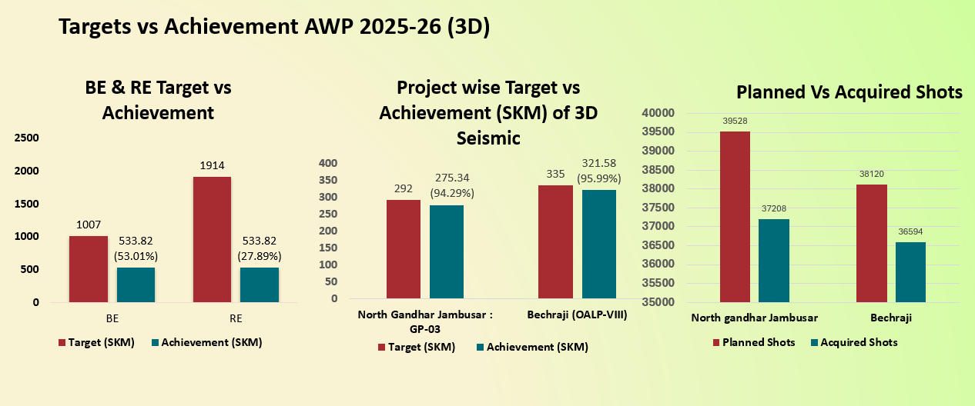
BE & RE Targets & Achievement 2025-26

Slide 6
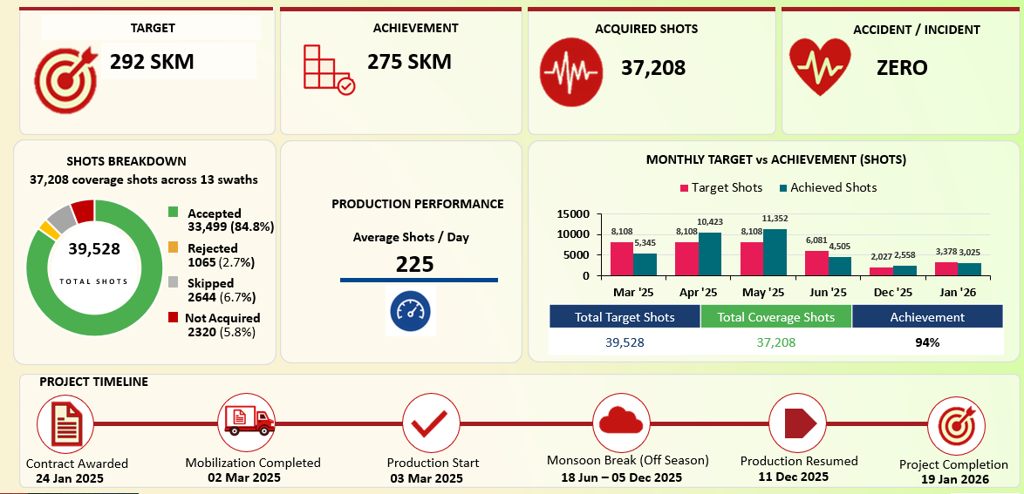
Production Statistics & Timeline of North Gandhar-Jambusar 2025-26

Slide 7

Geophysical Data Share Point (Knowledge Base)
Geophysical Data Share
Technical Presentations
Technical Reports
Published Technical Papers
SOPs / Guidelines
Data Acquisition Flow for Seismic, LFPS and VSP
Data Processing Work-Flow
Data QC Work-Flow
Quality Control Measures / LAMSDA (Quality Manual)
Important Formats (in Excel / PPT / Word File) – that can save our time.
Add relevant FAQ and Answer about Geophysical Data and Exploration Activity
Note: All user will be allowed to add their technical knowledge experience and expertise to the portal; few categories are listed above.

Slide 8
Structure of Uploaded Data (Data Sorting)
The right file name is very important for data shorting and search from the large pull or archival
File Name Format:
ProjectStartYear_GPxxSectionName_ProjectNumber_DataType_AreaField_ContractorName_SequenceNo.
Section/GPxx wise Data Classification:
All data uploaded on management dashboard must classify based on “GPxx /Section”.
The data must be displayed under GPxx/Section on the dashboard, no matter who is uploading the file (keeping data hierarchy in mind).

Slide 9



MAHAVIR SINGH
Scan QR
Geophysical Services | WON Basin
209 | Negi Bhawan | ONGC Vadodara | 390 009
_______________________________________
(M): +91-9428007223 | (O): 0265-260-3716
Email: singh_mahavir@ongc.co.in
_______________________________________
ONGC | India's Energy MAHARATNA
www.sparktriangle.com

Slide 10
Geophysical Service Vadodara – WebPage Structure
Major Structure
Geophysical Operations - Overview
Data Processing Center - Overview
Electronics Lab - Overview
Major Structure
Major Organogram (Organization Structure)
Geophysical Field Parties
Geophysical Data
Seismic Data
VSP Operations
LFPS Data

